Slide 1
Data Mining Techniques
DM is not so much a single technique, as the idea that there is more knowledge hidden in the data than shows itself on the surface.
Any data that helps extract more out of data is useful. So DM techniques form quite a heterogeneous group
Babu Ram Dawadi

Slide 2
DM Techniques..
Query tools
Statistical Techniques
Visualization
OLAP
Case-Based Learning (K- Nearest Neighbor)
Decision Trees
Association rules
Neural Network
Genetic Algorithms & many more…
Babu Ram Dawadi

Slide 3
Query Tools
The first step in data mining should always be a rough analysis of the data set using traditional query tools.
Applying simple SQL can achieve wealth of information
Almost 80% of the interesting information can be abstracted from a database using SQL,
The remaining 20% requires more advanced techniques where 20% hidden Information might have vital importance.
Babu Ram Dawadi

Slide 4
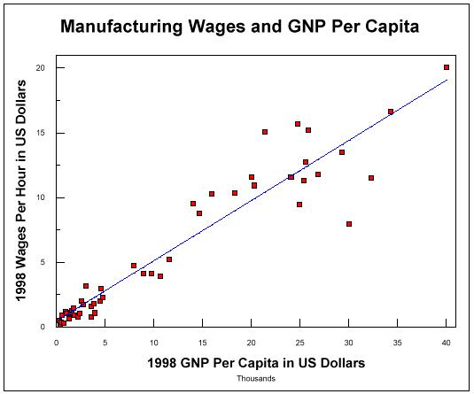
Statistical Methods (Statistical DM)
There are many well-established statistical techniques for data analysis, particularly for numeric data
  applied extensively to data from scientific experiments and data from economics and the social sciences
Regression
  predict the value of a response (dependent) variable from one or more predictor (independent) variables where the variables are numeric
Babu Ram Dawadi

Slide 5
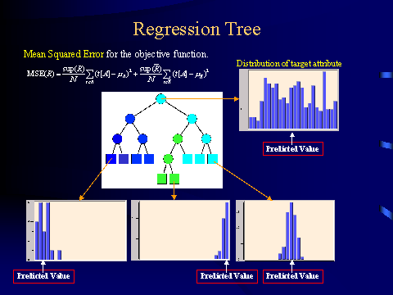
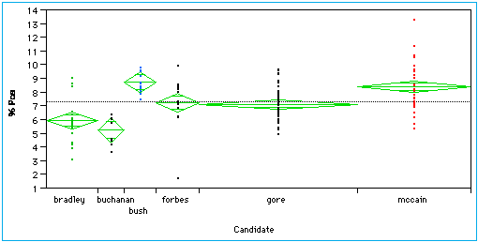
Statistical Methods (Statistical DM)
Regression trees
  Binary trees are used for classification and prediction
  Similar to decision trees:Tests are performed at the internal nodes
  In a regression tree the mean of the objective attribute is computed and used as the predicted value
Analysis of variance
  Analyze experimental data for two or more populations described by a numeric response variable and one or more categorical variables (factors)
Babu Ram Dawadi
Notes:
Mixed-effects models provide a powerful and flexible tool for the analysis of balanced and unbalanced grouped data. These data arise in several areas of investigation and are characterized by the presence of correlation between observations within the same group. Some examples are repeated measures data, longitudinal studies, and nested designs. Classical modeling techniques which assume independence of the observations are not appropriate for grouped data.

Slide 6
Visualization Techniques (Visual DM)
Visualization: use of computer graphics to create visual images which aid in the understanding of complex, often massive representations of data
Visual Data Mining: the process of discovering implicit but useful knowledge from large data sets using visualization techniques
Human Computer Interfaces
Computer Graphics
Multimedia Systems
High Performance Computing
Pattern Recognition
Babu Ram Dawadi

Slide 7
Visualization
Purpose of Visualization
  Gain insight into an information space by mapping data onto graphical primitives
  Provide qualitative overview of large data sets
  Search for patterns, trends, structure, irregularities, relationships among data.
  Help to find interesting regions and suitable parameters for further quantitative analysis.
  Provide a visual proof of computer representations derived
Babu Ram Dawadi

Slide 8
Data Mining Result Visualization
  Presentation of the results or knowledge obtained from data mining in visual forms
Examples
  Scatter plots
  Decision trees
  Association rules
  Clusters
  Outliers
Babu Ram Dawadi

Slide 9
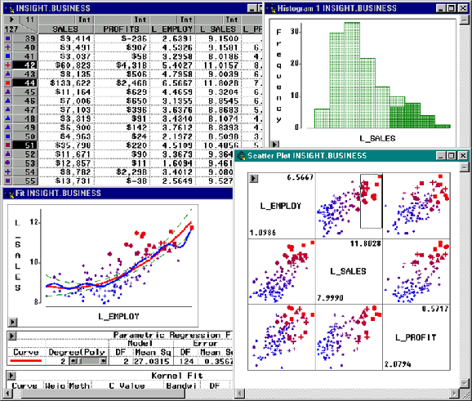
Visualization of Data Mining Results: Scatter Plots
Babu Ram Dawadi

Slide 10

Visualization of a Decision Tree : MineSet 3.0
Babu Ram Dawadi

Slide 11
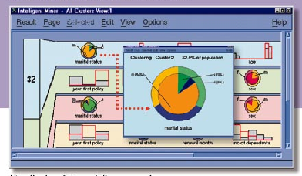
Visualization of Cluster Grouping in IBM Intelligent Miner
Babu Ram Dawadi

Slide 12
Data Mining Process Visualization
Presentation of the various processes of data mining in visual forms so that users can see
  Data extraction process
  Where the data is extracted
  How the data is cleaned, integrated, preprocessed, and mined
  Method selected for data mining
  Where the results are stored
  How they may be viewed
Babu Ram Dawadi

Slide 13
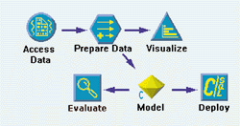
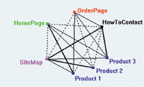
Visualization of Data Mining Processes by Clementine
E.g.: Knowledge Flow in WEKA
See your solution discovery process clearly
Understand variations with visualized data
Babu Ram Dawadi
Notes:
How the interactive Clementine knowledge discovery process works
See your solution discovery process clearly
The interactive stream approach to data mining is the key to Clementine's power. Using icons that represent steps in the data mining process, you mine your data by building a stream - a visual map of the process your data flows through. Start by simply dragging a source icon from the object palette onto the Clementine desktop to access your data flow. Then, explore your data visually with graphs. Apply several types of algorithms to build your model by simply placing the appropriate icons onto the desktop to form a stream.
Discover knowledge interactively
Data mining with Clementine is a "discovery-driven" process. Work toward a solution by applying your business expertise to select the next step in your stream, based on the discoveries made in the previous step. You can continually adapt or extend initial streams as you work through the solution to your business problem.
Easily build and test models
All of Clementine's advanced techniques work together to quickly give you the best answer to your business problems. You can build and test numerous models to immediately see which model produces the best result. Or you can even combine models by using the results of one model as input into another model. These "meta-models" consider the initial model's decisions and can improve results substantially.
Understand variations in your business with visualized data
Powerful data visualization techniques help you understand key relationships in your data and guide the way to the best results. Spot characteristics and patterns at a glance with Clementine's interactive graphs. Then "query by mouse" to explore these patterns by selecting subsets of data or deriving new variables on the fly from discoveries made within the graph.
How Clementine scales to the size of the challenge
The Clementine approach to scaling is unique in the way it aims to scale the complete data mining process to the size of large, challenging datasets. Clementine executes common operations used throughout the data mining process in the database through SQL queries. This process leverages the power of the database for faster processing, enabling you to get better results with large datasets.

Slide 14
Likelihood & Distance
Records that are close to each other are very alike & records that are vary far removed from each other represents individuals that have little in common.
Examples: 3 field values (age, income & Credit): these three attributes form a three dimensional data space and we can analyze the distances between records in this space.
Assume: Age range: 1 to 100 yrs, Income range: 0 to 100,000$ & Credit range: 0 to 50,000$
If it is used without correction, then income/credit is more distinctive than age. So for better analysis, we need coding.
Coding: divide income & age separation by 1000.
Babu Ram Dawadi

Slide 15
Likelihood & Distance
 | Age | Income | Credit
Customer 1 | 32 | 40,000 | 10,000
Customer 2 | 24 | 30,000 | 2,000
Differences | 8 | 10,000 | 8,000
Coding | 8 | 10 | 8
distance | SquareRoot(8*8+10*10+8*8)=15
Records Become points in Multidimensional data space
Customer 1
15
Customer 2
Babu Ram Dawadi

Slide 16
Likelihood & Distance
Sometimes it is possible to identify a visual cluster of potential Customers that are very likely to buy certain product
Babu Ram Dawadi

Slide 17
OLAP Tools
Idea of dimensionality (data are managed into multidimensional cube)
  Eg: how much is sold?? (Zero Dimensional)
  What type of magazines are sold in a designated area per month and to what age group? (a 4-dimensional question: product, area, purchase date and age)
OLAP Operations (Slicing,Dicing,Rolling,Drilling)
Babu Ram Dawadi

Slide 18
K-Nearest Neighbor
When we interpret records as points in a data space, we can define the concepts of neighborhood.
  “Records that are close to each other live in each others neighborhood.”
  “Records of the same type will be close to each other in the data space.”
  i.e. customers of same type will show same behavior.
Babu Ram Dawadi

Slide 19
K-Nearest Neighbor
Basic principle of K-nearest neighbor is
  “Do as your neighbor Do”
If we want to predict the behavior of certain individual, we first to look at the behavior of, for example: ten individuals that are close to him/her in the data space.
We calculate the average of 10 neighbors and this average value will be the prediction for our individual.
K=> No. of Neighbors. 5-Nearest neighbor => 5 neighbors to be taken for calculation
Babu Ram Dawadi

Slide 20
K-Nearest Neighbor
Draw Back
  If we want to make a prediction for each element in the data set containing n-records, then we have to compare each record with every other records which leads to complexity.
  For million records, we may need billion comparisons.
  So not desirable for large data sets.
  Doesn't work for high attributes or high dimensional data.
Babu Ram Dawadi

